Slide 1

The Battle for Schools
Coursera Applied Data Science Capstone Project
Ruolin Fan

Slide 2
Introduction
Hong Kong is a city with extremely high population density and diverse culture. Different districts may possess very different features and environment.
Education has always been a hot topic and attracts a lot of attentions in HK society. While the educational resources and cultural influences may differ in these different types of schools, the neighborhood around these schools may also have certain patterns that might be influential to the students.
In an attempt to focus on education in the context of Hong Kong districts, the following questions/aims are raised for this project:

Slide 3
Questions
Are there any general features for venues nearby primary schools? Can these features help group schools into clusters?
If the schools can be clustered, does it correlate to its category (government, private, international, etc.?), or the district where it is located?
Is educational resource correlated with other features of the district, e.g. household income, rent, etc.?
From the above observations, generate implications for students, parents or educators

Slide 4
Data
List for primary schools with classified types and location (https://geodata.gov.hk/gs/)
Ranking of 100 primary schools based on multiple factors.
Tuition of 54 primary schools.
Area of 18 districts (https://opendata.esrichina.hk/datasets/eea8ff2f12b145f7b33c4eef4f045513_0/data?orderBy=ENAME)
Statistics of 18 districts: median monthly domestic household rent, median monthly domestic household income, median mortgage payment and loan repayment, median rent to income ratio, etc. (https://data.gov.hk/en/geospatial-data)

Slide 5
Methodology
Primary school data
Location (x, y)
Other features
Dataset (funding)
Student gender
Religion
Nearby venues (Foursquare)
Primary school ranking (scores)
10 most common categories
Dython
(http://shakedzy.xyz/dython/)
Kmeans Clustering
Primary school tuitions
Cluster labels
18 Districts statistics
Dython
Group by districts
Pearson’s R for continuous-continuous cases
Correlation Ratio for categorical-continuous cases
Cramer’s V or Theil’s U for categorical-categorical cases
Dython

Slide 6

Results
1. Features and distribution of schools

Slide 7
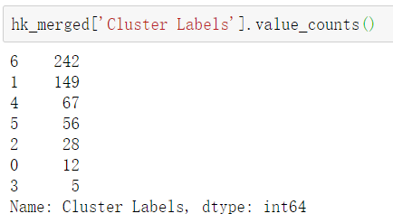
Distribution of schools
-- Classify by clusters --

Slide 8
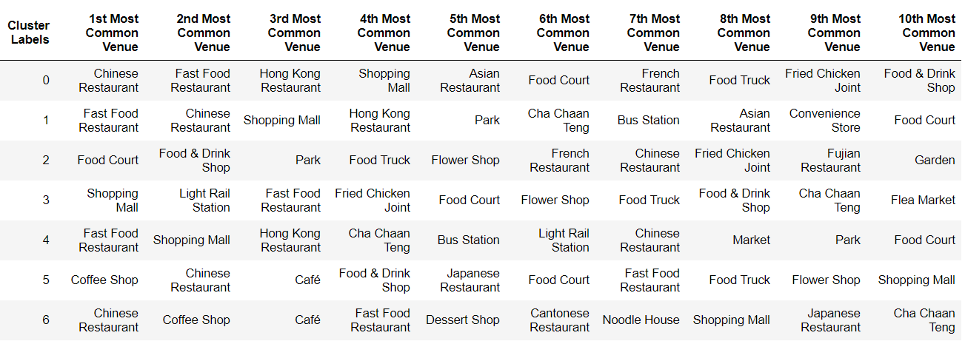
Clustering based on nearby venues
The 10 most common venue categories in each cluster of schools

Slide 9
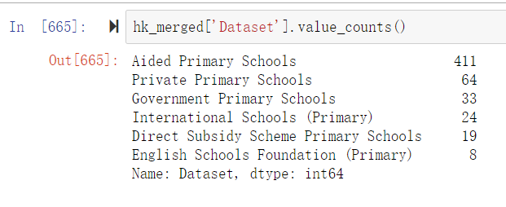
Distribution of schools
-- Classify by datasets --

Slide 10
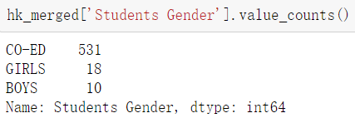
Distribution of schools
-- Classify by student genders --

Slide 11
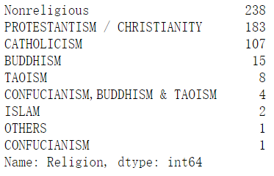
Distribution of schools
-- Classify by religions--

Slide 12
Results
2. Scoring of schools and the correlations between evaluating factors

Slide 13
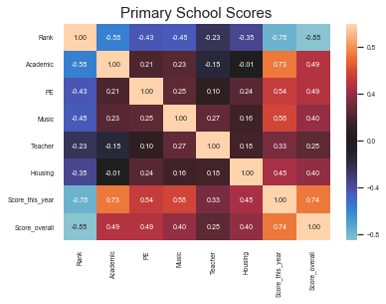
Ranking has negative correlation with other variables
The overall score also has a relatively high correlation with other factors, especially the score this year
Teacher has quite low correlation with all factors but music (excluding Score_this_year or score_overall)
Housing is most highly correlated with PE
Teacher and housing scores are even negatively correlated with academic

Slide 14
Results
3. Correlations between all features including score and tuition

Slide 15
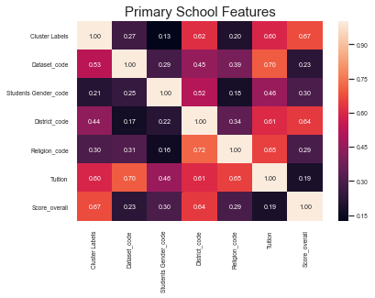
Tuition
Weak positive correlation between tuition and overall score.
Highly scored schools don’t necessarily need higher tuition.
Small sample size → not representative.
Different method for correlation computation → incomparable
Tuition has highest correlation with dataset
Other features

Slide 16
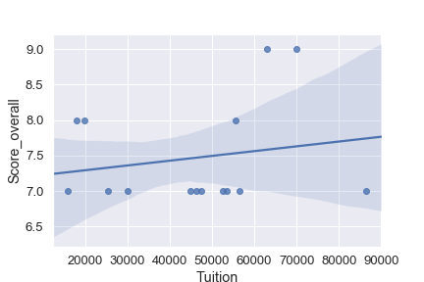
Tuition
Weak positive correlation between tuition and overall score.
Highly scored schools don’t necessarily need higher tuition.
Small sample size → not representative.
Different method for correlation computation → incomparable
Tuition has highest correlation with dataset
Other features

Slide 17
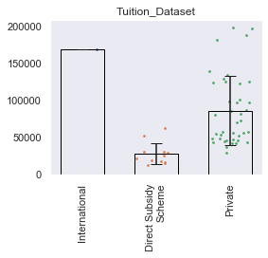
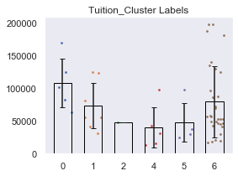
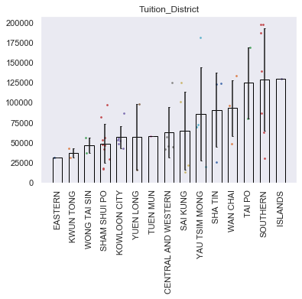
Tuition
Weak positive correlation between tuition and overall score.
Highly scored schools don’t necessarily need higher tuition.
Small sample size → not representative.
Different method for correlation computation → incomparable
Tuition has highest correlation with dataset
Other features

Slide 18
Overall Score
Overall score is especially highly correlated with cluster label and district
However, differences between the groups are small.
A few schools with top scores are located in Kowloon City, Yau Tsim Mong and Southern districts
Direct subsidy scheme schools and private schools tend to have higher scores
Single-gender schools tend to have higher score than Co-ed schools.

Slide 19
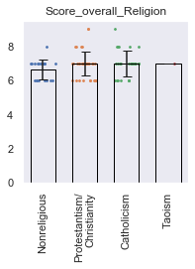
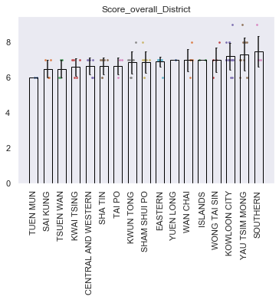
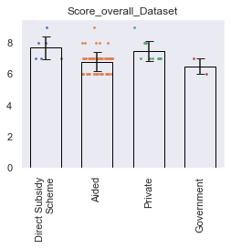
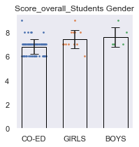
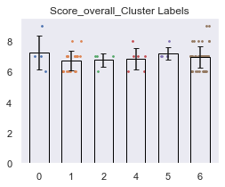
Overall Score
Overall score is especially highly correlated with cluster label and district
However, differences between the groups are small.
A few schools with top scores are located in Kowloon City, Yau Tsim Mong and Southern districts
Direct subsidy scheme schools and private schools tend to have higher scores
Single-gender schools tend to have higher score than Co-ed schools.

Slide 20
Results
4. Correlations between school distribution in 18 districts and domestic statistics

Slide 21
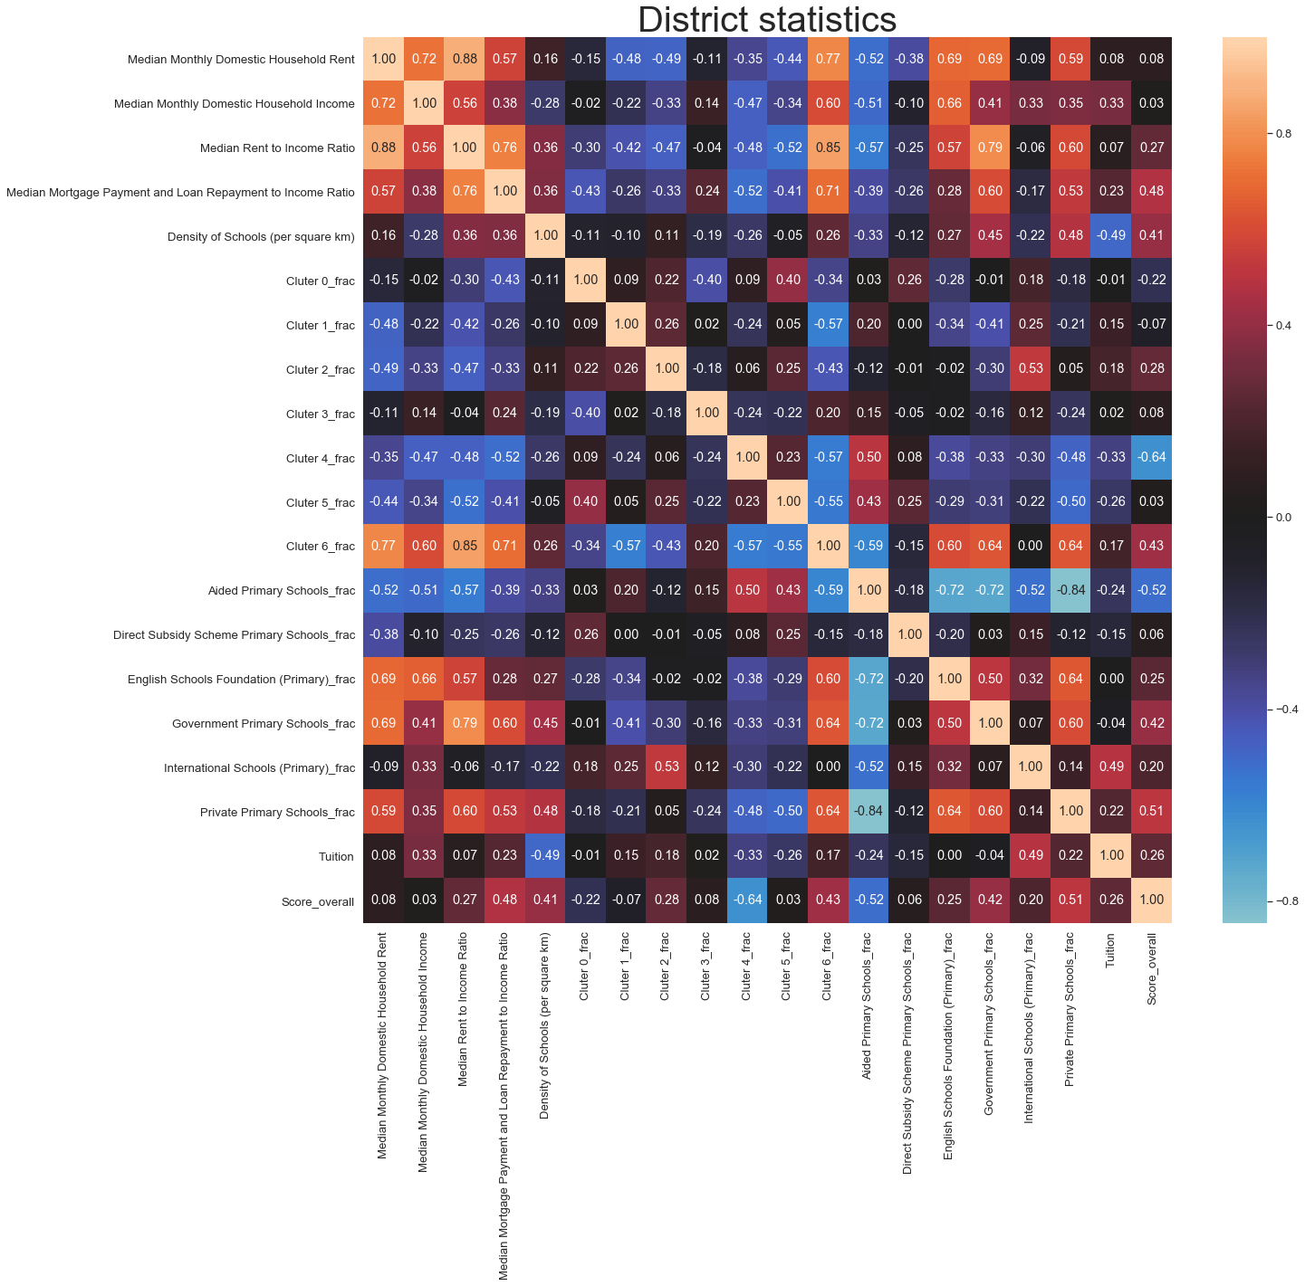
Four domestic income and rent statistics are positively correlated with each other.
Only the Median Monthly Domestic Household Income is negatively correlated with the density of schools (with two outliers).
Cluster 6 and Aided Primary School are the most distinct categories (due to abundance?)
Overall score is positively correlated with all dataset categories except Aided Primary Schools
Average tuition has an apparent negative correlation with density of schools (supply-demand relationship).
A type of districts dominated by cluster 6 schools and correlated with lower proportion of Aided Primary Schools (e.g. Central and Western, Wanchai & Yau Tsim Mong)

Slide 22
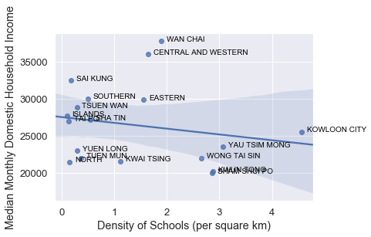
Four domestic income and rent statistics are positively correlated with each other.
Only the Median Monthly Domestic Household Income is negatively correlated with the density of schools (with two outliers).
Cluster 6 and Aided Primary School are the most distinct categories (due to abundance?)
Overall score is positively correlated with all dataset categories except Aided Primary Schools
Average tuition has an apparent negative correlation with density of schools (supply-demand relationship).
A type of districts dominated by cluster 6 schools and correlated with lower proportion of Aided Primary Schools (e.g. Central and Western, Wanchai & Yau Tsim Mong)

Slide 23
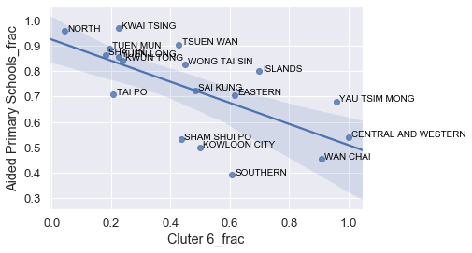
Four domestic income and rent statistics are positively correlated with each other.
Only the Median Monthly Domestic Household Income is negatively correlated with the density of schools (with two outliers).
Cluster 6 and Aided Primary School are the most distinct categories (due to abundance?)
Overall score is positively correlated with all dataset categories except Aided Primary Schools
Average tuition has an apparent negative correlation with density of schools (supply-demand relationship).
A type of districts dominated by cluster 6 schools and correlated with lower proportion of Aided Primary Schools (e.g. Central and Western, Wanchai & Yau Tsim Mong)

Slide 24
Discussion & Conclusion

Slide 25

Conclusions
The results revealed a largely similar pool of common venue categories near primary schools, which are mainly restaurants and food shops.
A certain cluster (cluster 6) is predominant and seems to have a correlation with the most common type of school (aided primary school). The schools in this cluster is especially abundant in Wan Chai, Central and Western, and Yau Tsim Mong districts, which share many similarities in statistics like “Median Rent to Income Ratio”.
Economic features of a district are correlated with the neighborhood and environment, including the localization of primary schools.

Slide 26
Limitations
The features used for clustering is essentially not very differentiating and may not be directly related to other features (e.g. tuition and score, etc.).
Not extracting rating information for these venues for more interesting analysis that might be useful for business purposes
Single data source for data of tuition and scores that was not evaluated for the credibility due to the limit of resource.

Slide 27
Significance
Provides an overview about the general features and distributions of primary schools in Hong Kong
A reference for parents to have an idea about the basic features of each district and the education resources.
Far from extrapolating any social inferences or decisive conclusions from this simple analysis due to a severe lack of additional information and research.

